Slide 1
Web Developement
Unit 02: Client-Side Technologies: Java-Script and DOM
Introduction:
-Java-Script (JS) is the most popular lightweight, interpreted compiled programming language. It can be used for both Client-side as well as Server-side developments. Java-Script also known as a scripting language for web pages.
Why to use JAVA SCRIPT:
-Java-Script is used by many developers, and the number is increasing day by day.
It is preferred over any other programming language by most developers.
Also, major tech companies like Microsoft, Uber, Google, Netflix, and Meta use Java-Script in their projects.
Java-Script can be added to your HTML file in two ways:
Internal Java-Script & External Java-Script :
Internal Java-Script: We can add JS code directly to our HTML file by writing the code inside the <script> & </script>. The <script> tag can either be placed inside the <head> or the <body> tag according to the requirement.
External Java-Script: We can create the file with a .js extension and paste the JS code inside of it. After creating the file, add this file in <script src=”file_name.js”> tag, and this <sctipt> can import inside <head> or <body> tag of the HTML file.

Slide 2
Web Developement
Unit 02: Client-Side Technologies: Java-Script and DOM
Applications of Java-Script Programming:
As mentioned before, Java-Script is one of the most widely used programming languages (Front-end as well as Back-end). It has it's presence in almost every area of software development.
1)Client side validation - This is really important to verify any user input before submitting it to the server and Java-Script plays an important role in validting those inputs at front-end itself.
2)Manipulating HTML Pages - Java-Script helps in manipulating HTML page on the fly. This helps in adding and deleting any HTML tag very easily using Java-Script and modify your HTML to change its look and feel based on different devices and requirements.
3)User Notifications - You can use Java-Script to raise dynamic pop-ups on the webpages to give different types of notifications to your website visitors.
4)Back-end Data Loading - Java-Script provides Ajax library which helps in loading back-end data while you are doing some other processing. This really gives an amazing experience to your website visitors.
5) Presentations - Java-Script also provides the facility of creating presentations which gives website look and feel
6)Server Applications - Node JS is built on Chrome's Java-Script runtime for building fast and scalable network applications. This is an event based library which helps in developing very sophisticated server applications including Web Servers.

Slide 3
Web Developement
Unit 02: Client-Side Technologies: Java-Script and DOM
Advantages of JavaScript:
The merits of using JavaScript are −
1) Less server interaction − You can validate user input before sending the page off to the server. This saves server traffic, which means less load on your server.
2) Immediate feedback to the visitors − They don't have to wait for a page reload to see if they have forgotten to enter something.
3) Increased interactivity − You can create interfaces that react when the user hovers over them with a mouse or activates them via the keyboard.
4) Richer interfaces − You can use JavaScript to include such items as drag-and-drop components and sliders to give a Rich Interface to your site visitors.
Limitations of JavaScript:
We cannot treat JavaScript as a full-fledged programming language. It lacks the following important features −
1) Client-side JavaScript does not allow the reading or writing of files. This has been kept for security reason.
2) JavaScript cannot be used for networking applications because there is no such support available.
3) JavaScript doesn't have any multi-threading or multiprocessor capabilities.

Slide 4
Web Developement
Unit 02: Client-Side Technologies: Java-Script and DOM
Your First JavaScript Code
<html>
<body>
<script language = "javascript" type = "text/javascript">
<!--
document.write(“Wel-come to CSMSS, CSCOE")
//-->
</script>
</body>
</html>

Slide 5
Web Developement
Unit 02: Client-Side Technologies: Java-Script and DOM
-Types of Java-Script Comments:
There are two types of comments in Java-Script.
Single-line Comment & Multi-line Comment
1) Java-Script Single line Comment
It is represented by double forward slashes (//). It can be used before and after the statement.
<script>
// It is single line comment
document.write("hello Java-Script");
</script>
2) Java-Script Multi line Comment
It can be used to add single as well as multi line comments. So, it is more convenient.
<script>
/* It is multi line comment.
It will not be displayed */
document.write("example of Java-Script multiline comment");
</script>

Slide 6
Web Developement
Unit 02: Client-Side Technologies: Java-Script and DOM
Java-Script Variable:
-A Java-Script variable is simply a name of storage location. There are two types of variables in Java-Script : local variable and global variable.
-There are some rules while declaring a Java-Script variable (also known as identifiers).
1) Name must start with a letter (a to z or A to Z), underscore( _ ), or dollar( $ ) sign.
2) After first letter we can use digits (0 to 9), for example value1.
3) Java-Script variables are case sensitive, for example x and X are different variables.
Example:
var x = 10;
var _value=“CSMSS";

Slide 7
Web Developement
Unit 02: Client-Side Technologies: Java-Script and DOM
-Java-Script local variable
A Java-Script local variable is declared inside block or function. It is accessible within the function or block only. For example:
<script>
function abc() {
var x=10;//local variable
} </script>
-Java-Script global variable
A Java-Script global variable is accessible from any function. A variable i.e. declared outside the function or declared with window object is known as global variable. For example:
<script>
var data=200;//gloabal variable
function a(){
document.writeln(data); }
function b(){
document.writeln(data); }
a();//calling Java-Script function
b();
</script>

Slide 8
Web Developement
Unit 02: Client-Side Technologies: Java-Script and DOM
Data Types:
-JavaScript provides different data types to hold different types of values.
-There are two types of data types in JavaScript.
1) Primitive data type 2) Non-primitive (reference) data type
-JavaScript is a dynamic type language, means you don't need to specify type of the variable because it is dynamically used by JavaScript engine.
-You need to use var here to specify the data type. It can hold any type of values such as numbers, strings etc. For example:
var a=40; //holding number
var b="Rahul"; //holding string
JavaScript primitive data types:
There are five types of primitive data types in JavaScript. They are as follows:
Data Type Description
1) String represents sequence of characters e.g. "hello"
2) Number represents numeric values e.g. 100
3) Boolean represents boolean value either false or true
4) Undefined represents undefined value
5) Null represents null i.e. no value at all

Slide 9
Web Developement
Unit 02: Client-Side Technologies: Java-Script and DOM
JavaScript non-primitive data types :
The non-primitive data types are as follows:
Data Type Description
1) Object represents instance through which we can access members
2) Array represents group of similar values
3) RegExp represents regular expression

Slide 10
Web Developement
Unit 02: Client-Side Technologies: Java-Script and DOM
- JavaScript Operators
JavaScript operators are symbols that are used to perform operations on operands. For example:
There are following types of operators in JavaScript.
Arithmetic Operators
Comparison (Relational) Operators
Bitwise Operators
Logical Operators
Assignment Operators
Special Operators

Slide 11
Web Developement
Unit 02: Client-Side Technologies: Java-Script and DOM
1) JavaScript Arithmetic Operators
Arithmetic operators are used to perform arithmetic operations on the operands. The following operators are known as JavaScript arithmetic operators.
Operator | Description | Example
+ | Addition | 10+20 = 30
- | Subtraction | 20-10 = 10
* | Multiplication | 10*20 = 200
/ | Division | 20/10 = 2
% | Modulus (Remainder) | 20%10 = 0
++ | Increment | var a=10; a++; Now a = 11
-- | Decrement | var a=10; a--; Now a = 9

Slide 12
Web Developement
Unit 02: Client-Side Technologies: Java-Script and DOM
- JavaScript Comparison Operators
The JavaScript comparison operator compares the two operands. The comparison operators are as follows:
Operator | Description | Example
== | Is equal to | 10==20 = false
=== | Identical (equal and of same type) | 10==20 = false
!= | Not equal to | 10!=20 = true
!== | Not Identical | 20!==20 = false
> | Greater than | 20>10 = true
>= | Greater than or equal to | 20>=10 = true
< | Less than | 20<10 = false
<= | Less than or equal to | 20<=10 = false

Slide 13
Web Developement
Unit 02: Client-Side Technologies: Java-Script and DOM
- JavaScript Bitwise Operators
The bitwise operators perform bitwise operations on operands. The bitwise operators are as follows:
Operator | Description | Example
& | Bitwise AND | (10==20 & 20==33) = false
| | Bitwise OR | (10==20 | 20==33) = false
^ | Bitwise XOR | (10==20 ^ 20==33) = false
~ | Bitwise NOT | (~10) = -10
<< | Bitwise Left Shift | (10<<2) = 40
>> | Bitwise Right Shift | (10>>2) = 2
>>> | Bitwise Right Shift with Zero | (10>>>2) = 2

Slide 14
Web Developement
Unit 02: Client-Side Technologies: Java-Script and DOM
- JavaScript Logical Operators
The following operators are known as JavaScript logical operators.
Operator | Description | Example
&& | Logical AND | (10==20 && 20==33) = false
|| | Logical OR | (10==20 || 20==33) = false
! | Logical Not | !(10==20) = true

Slide 15
Web Developement
Unit 02: Client-Side Technologies: Java-Script and DOM
- JavaScript Assignment Operators
The following operators are known as JavaScript assignment operators.
Operator | Description
(?:) | Conditional Operator returns value based on the condition. It is like if-else.
, | Comma Operator allows multiple expressions to be evaluated as single statement.
delete | Delete Operator deletes a property from the object.
in | In Operator checks if object has the given property
instanceof | checks if the object is an instance of given type
new | creates an instance (object)
typeof | checks the type of object.
void | it discards the expression's return value.
yield | checks what is returned in a generator by the generator's iterator.

Slide 16
Web Developement
Unit 02: Client-Side Technologies: Java-Script and DOM
JavaScript Functions:
JavaScript functions are used to perform operations. We can call JavaScript function many times to reuse the code.
Advantage of JavaScript function:
There are mainly two advantages of JavaScript functions.
1) Code reusability: We can call a function several times so it save coding.
2) Less coding: It makes our program compact. We don’t need to write many lines of code each time to perform a common task.
JavaScript Function Syntax:
The syntax of declaring function is given below.
function functionName([arg1, arg2, ...argN])
{
//code to be executed
}

Slide 17
Web Developement
Unit 02: Client-Side Technologies: Java-Script and DOM
- JavaScript Function Example
Let’s see the simple example of function in JavaScript that does not has arguments.
<script>
function msg()
{
alert(“Wel Come to CSMSS, CSCOE");
}
JavaScript Function Arguments:
We can call function by passing arguments. Example:
<script>
function getcube(number)
{
alert(number*number*number);
}
Function with Return Value
We can call function that returns a value and use it in our program.
<script>
function getInfo() {
return "hello javatpoint! How r u?";
}

Slide 18
Web Developement
Unit 02: Client-Side Technologies: Java-Script and DOM
JavaScript Objects:
-A javaScript object is an entity having state and behavior (properties and method). For example: car, pen, bike, chair, glass, keyboard, monitor etc.
-JavaScript is an object-based language. Everything is an object in JavaScript.
Creating Objects in JavaScript:
There are 3 ways to create objects.
By object literal
By creating instance of Object directly (using new keyword)
By using an object constructor (using new keyword)
1) JavaScript Object by object literal
The syntax of creating object using object literal is given below:
object={property1:value1,property2:value2.....propertyN:valueN}
Ex: <script>
emp={id:102,name:“Sonu Kapoor",salary:40000}
document.write(emp.id+" "+emp.name+" "+emp.salary);
</script>

Slide 19
Web Developement
Unit 02: Client-Side Technologies: Java-Script and DOM
-2) By creating instance of Object
The syntax of creating object directly is given below:
var objectname=new Object();
Here, new keyword is used to create object.
Let’s see the example of creating object directly.
<script>
var emp=new Object();
emp.id=101;
emp.name="Ravi Malik";
emp.salary=50000;
document.write(emp.id+" "+emp.name+" "+emp.salary);
</script>

Slide 20
Web Developement
Unit 02: Client-Side Technologies: Java-Script and DOM
-3) By using an Object constructor
Here, you need to create function with arguments. Each argument value can be assigned in the current object by using this keyword.
The this keyword refers to the current object.
The example of creating object by object constructor is given below.
<script>
function emp(id,name,salary){
this.id=id;
this.name=name;
this.salary=salary;
}
e=new emp(103,"Vimal Jaiswal",30000);
document.write(e.id+" "+e.name+" "+e.salary);
</script>

Slide 21
Web Developement
Unit 02: Client-Side Technologies: Java-Script and DOM
-JavaScript Object Methods
The various methods of Object are as follows:
S.No | Methods | Description
1 | Object.assign() | This method is used to copy enumerable and own properties from a source object to a target object
2 | Object.create() | This method is used to create a new object with the specified prototype object and properties.
3 | Object.defineProperty() | This method is used to describe some behavioral attributes of the property.
4 | Object.defineProperties() | This method is used to create or configure multiple object properties.
5 | Object.entries() | This method returns an array with arrays of the key, value pairs.
6 | Object.freeze() | This method prevents existing properties from being removed.

Slide 22
Web Developement
Unit 02: Client-Side Technologies: Java-Script and DOM
-
7 | Object.getOwnPropertyDescriptor() | This method returns a property descriptor for the specified property of the specified object.
8 | Object.getOwnPropertyDescriptors() | This method returns all own property descriptors of a given object.
9 | Object.getOwnPropertyNames() | This method returns an array of all properties (enumerable or not) found.
10 | Object.getOwnPropertySymbols() | This method returns an array of all own symbol key properties.
11 | Object.getPrototypeOf() | This method returns the prototype of the specified object.
12 | Object.is() | This method determines whether two values are the same value.
13 | Object.isExtensible() | This method determines if an object is extensible
14 | Object.isFrozen() | This method determines if an object was frozen.
15 | Object.isSealed() | This method determines if an object is sealed.

Slide 23
Web Developement
Unit 02: Client-Side Technologies: Java-Script and DOM
-
16 | Object.keys() | This method returns an array of a given object's own property names.
17 | Object.preventExtensions() | This method is used to prevent any extensions of an object.
18 | Object.seal() | This method prevents new properties from being added and marks all existing properties as non-configurable.
19 | Object.setPrototypeOf() | This method sets the prototype of a specified object to another object.
20 | Object.values() | This method returns an array of values.

Slide 24
Web Developement
Unit 02: Client-Side Technologies: Java-Script and DOM
Document Object Model:
-The document object represents the whole html document.
-When html document is loaded in the browser, it becomes a document object.
-It is the root element that represents the html document.
-It has properties and methods. By the help of document
object, we can add dynamic content to our web page.
window.document

Slide 25
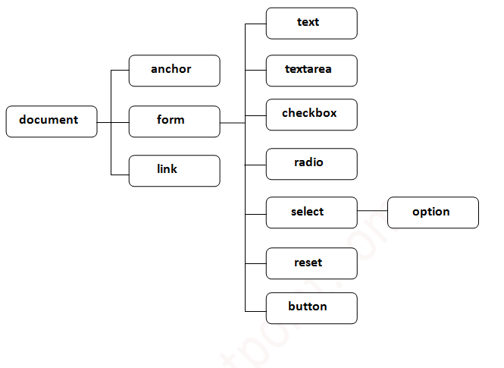
Web Developement
Unit 02: Client-Side Technologies: Java-Script and DOM
Properties of document object:
Let's see the properties of document object that can be accessed and modified by the document object.

Slide 26
Web Developement
Unit 02: Client-Side Technologies: Java-Script and DOM
-Methods of document object
We can access and change the contents of document by its methods.
The important methods of document object are as follows:
Method | Description
write("string") | writes the given string on the doucment.
writeln("string") | writes the given string on the doucment with newline character at the end.
getElementById() | returns the element having the given id value.
getElementsByName() | returns all the elements having the given name value.
getElementsByTagName() | returns all the elements having the given tag name.
getElementsByClassName() | returns all the elements having the given class name.

Slide 27
Web Developement
Unit 02: Client-Side Technologies: Java-Script and DOM
-Accessing field value by document object
In this example, we are going to get the value of input text by user. Here, we are using document.form1.name.value to get the value of name field.
Here, document is the root element that represents the html document.
form1 is the name of the form.
name is the attribute name of the input text.
value is the property, that returns the value of the input text.
Javascript - document.getElementById() method
The document.getElementById() method returns the element of specified id.
In the previous page, we have used document.form1.name.value to get the value of the input value. Instead of this, we can use document.getElementById() method to get value of the input text. But we need to define id for the input field.

Slide 28
Enter No:
Web Developement
Unit 02: Client-Side Technologies: Java-Script and DOM
-Let's see the simple example of document.getElementById() method that prints cube of the given number.
<script type="text/javascript">
function getcube(){
var number=document.getElementById("number").value;
alert(number*number*number);
}
</script>
<form>
Enter No:<input type="text" id="number" name="number"/><br/>
<input type="button" value="cube" onclick="getcube()"/>
</form>
Output of the above example
Enter No: |Text Box|
|Button|

Slide 29
Web Developement
Unit 02: Client-Side Technologies: Java-Script and DOM
-Javascript - document.getElementsByName() method
The document.getElementsByName() method returns all the element of specified name.
The syntax of the getElementsByName() method is given below
document.getElementsByName("name")
Here, name is required
Example of document.getElementsByName() method
<script type="text/javascript">
function total_elements()
{
var allgenders=document.getElementsByName("gender");
alert("Total Genders:"+allgenders.length);
}
</script>
<form>
Male:<input type="radio" name="gender" value="male">
Female:<input type="radio" name="gender" value="female">
<input type="button" onclick="total_elements()" value="Total Genders">
</form>

Slide 30
Web Developement
Unit 02: Client-Side Technologies: Java-Script and DOM
-Output of the above example
Male: Female: | Total Gender |
Javascript - document.getElementsByTagName() method
The document.getElementsByTagName() method returns all the element of specified tag name.
The syntax of the getElementsByTagName() method is given below:
document.getElementsByTagName("name")
Here, name is required.

Slide 31
Web Developement
Unit 02: Client-Side Technologies: Java-Script and DOM
JavaScript Events:
-The change in the state of an object is known as an Event.
-In html, there are various events which represents that some activity is performed by the user or by the browser.
When javascript code is included in HTML, js react over these events and allow the execution.
This process of reacting over the events is called Event Handling. Thus, js handles the HTML events via Event Handlers.
Some of the HTML events and their event handlers are:
Mouse events:
Event Performed | Event Handler | Description
click | onclick | When mouse click on an element
mouseover | onmouseover | When the cursor of the mouse comes over the element
mouseout | onmouseout | When the cursor of the mouse leaves an element
mousedown | onmousedown | When the mouse button is pressed over the element
mouseup | onmouseup | When the mouse button is released over the element
mousemove | onmousemove | When the mouse movement takes place.

Slide 32
Web Developement
Unit 02: Client-Side Technologies: Java-Script and DOM
JavaScript Events:
-The change in the state of an object is known as an Event.
-In html, there are various events which represents that some activity is performed by the user or by the browser.
When javascript code is included in HTML, js react over these events and allow the execution.
This process of reacting over the events is called Event Handling. Thus, js handles the HTML events via Event Handlers.
Some of the HTML events and their event handlers are:
Mouse events:
Event Performed | Event Handler | Description
click | onclick | When mouse click on an element
mouseover | onmouseover | When the cursor of the mouse comes over the element
mouseout | onmouseout | When the cursor of the mouse leaves an element
mousedown | onmousedown | When the mouse button is pressed over the element
mouseup | onmouseup | When the mouse button is released over the element
mousemove | onmousemove | When the mouse movement takes place.

Slide 33
Web Developement
Unit 02: Client-Side Technologies: Java-Script and DOM
-Keyboard events:
Form Events:
Event Performed | Event Handler | Description
Keydown & Keyup | onkeydown & onkeyup | When the user press and then release the key
Event Performed | Event Handler | Description
focus | onfocus | When the user focuses on an element
submit | onsubmit | When the user submits the form
blur | onblur | When the focus is away from a form element
change | onchange | When the user modifies or changes the value of a form element

Slide 34
Web Developement
Unit 02: Client-Side Technologies: Java-Script and DOM
Examples over events and their handlers:
Click Events:
<html>
<head> Javascript Events </head>
<body>
<script language="Javascript" type="text/Javascript">
<!--
function clickevent()
{
document.write(“This is CSMSS");
}
//-->
</script>
<form>
<input type="button" onclick="clickevent()" value="Who's this?"/>
</form>
</body>
</html>

Slide 35
Web Developement
Unit 02: Client-Side Technologies: Java-Script and DOM
-MouseOver Event:
<html>
<head>
<h1> Javascript Events </h1>
</head>
<body>
<script language="Javascript" type="text/Javascript">
<!--
function mouseoverevent()
{
alert("This is CSMSS, CSCOE"");
}
//-->
</script>
<p onmouseover="mouseoverevent()"> Keep cursor over me</p>
</body>
</html>

Slide 36
Web Developement
Unit 02: Client-Side Technologies: Java-Script and DOM
-Focus Event:
<html>
<head> Javascript Events</head>
<body>
<h2> Enter something here</h2>
<input type="text" id="input1" onfocus="focusevent()"/>
<script>
<!--
function focusevent()
{
document.getElementById("input1").style.background=" Blue";
}
//-->
</script>
</body>
</html>

Slide 37
Web Developement
Unit 02: Client-Side Technologies: Java-Script and DOM
-Keyboard Event:
<html>
<head> Javascript Events</head>
<body>
<h2> Enter something here</h2>
<input type="text" id="input1" onkeydown="keydownevent()"/>
<script>
<!--
function keydownevent()
{
document.getElementById("input1");
alert("Pressed a key");
}
//-->
</script>
</body>
</html>

Slide 38
Web Developement
Unit 02: Client-Side Technologies: Java-Script and DOM
-Load Event:
<html>
<head>Javascript Events</head>
</br>
<body onload="window.alert('Page successfully loaded');">
<script>
<!--
document.write("The page is loaded successfully");
//-->
</script>
</body>
</html>

Slide 39
Web Developement
Unit 02: Client-Side Technologies: Java-Script and DOM
JavaScript addEventListener()
-The addEventListener() method makes it easier to control how the event reacts to bubbling.
-When using the addEventListener() method, the JavaScript is separated from the HTML markup, for better readability and allows you to add event listeners even when you do not control the HTML markup.
-When a user or browser interacts with a webpage, an event occurs. Event handlers are used to create a customized piece of code that will run in response to specific events (e.g., opening a pop-up window when a user clicks a button).
-The addEventListener() method is an inbuilt function of JavaScript. We can add multiple event handlers to a particular element without overwriting the existing event handlers.
Syntax:
element.addEventListener(event, function, useCapture);

Slide 40
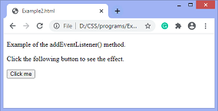
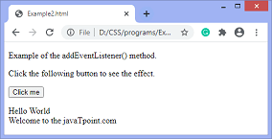
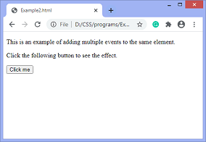
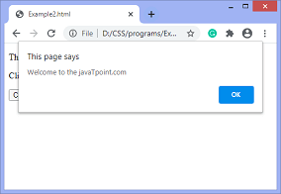
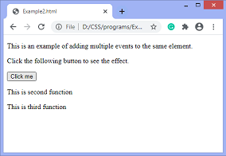
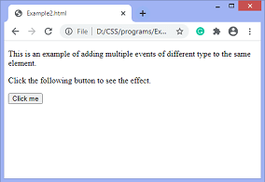
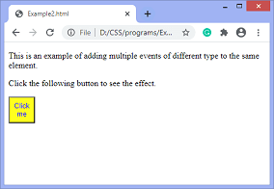
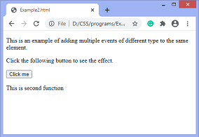
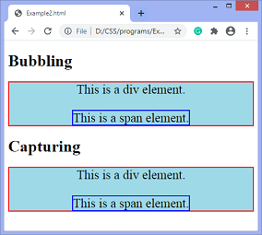
Web Developement
Unit 02: Client-Side Technologies: Java-Script and DOM
-Although it has three parameters, the parameters event and function are widely used. The third parameter is optional to define. The values of this function are defined as follows.
Parameter Values
event: It is a required parameter. It can be defined as a string that specifies the event's name
function: It is also a required parameter. It is a JavaScript function which responds to the event occur.
useCapture: It is an optional parameter. It is a Boolean type value that specifies whether the event is executed in the bubbling or capturing phase. When it is set to true, the event handler executes in the capturing phase. When it is set to false, the handler executes in the bubbling phase. Its default value is false.

Slide 41
Web Developement
Unit 02: Client-Side Technologies: Java-Script and DOM
-The DOM is a TREE:
-The DOM is a tree-like representation of the web page that gets loaded into the browser.
-A Document Object Model (DOM) tree is a hierarchical representation of an HTML or XML document.
-It consists of a root node, which is the document itself, and a series of child nodes that represent the elements, attributes, and text content of the document.
- It represents the web page using a‌‌ series of objects. The main object is the document object, which in turn houses other objects which also house their own objects, and so on.

Slide 42
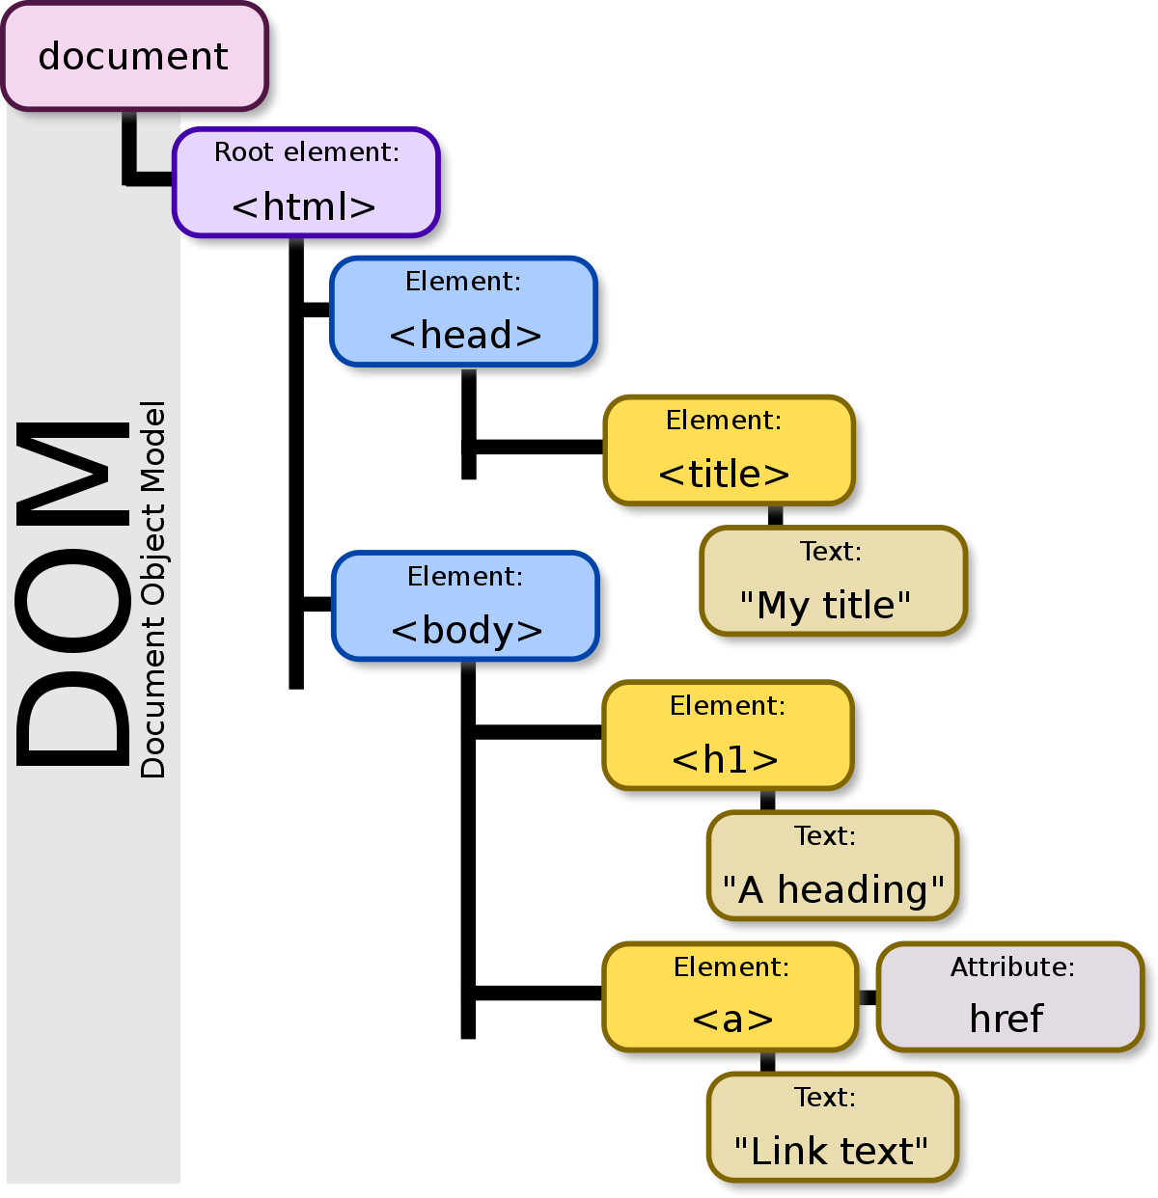
Web Developement
Unit 02: Client-Side Technologies: Java-Script and DOM
-The DOM is a TREE STRUCTURE:

Slide 43
Web Developement
Unit 02: Client-Side Technologies: Java-Script and DOM
- jQuery
-jQuery is a JavaScript framework designed to simplify HTML DOM tree traversal and manipulation, as well as event handling, CSS animation, and Ajax
jQuery is an open source JavaScript library that simplifies the interactions between an HTML/CSS document, or more precisely the Document Object Model (DOM), and JavaScript.
“Write less, do more.”
jQuery Features
Following are the important features of jQuery.
HTML manipulation
DOM manipulation
DOM element selection
CSS manipulation
Effects and Animations
Utilities
AJAX
HTML event methods
JSON Parsing
Extensibility through plug-ins

Slide 44
Web Developement
Unit 02: Client-Side Technologies: Java-Script and DOM
Basic syntax for any jQuery function is:
$(selector).action()
$ sign to define/access jQuery
(selector) to "query (or find)" HTML elements
jQuery action() to be performed on the element(s)
How to Call a jQuery Library Functions?
-we need to make sure that we start adding events etc. as soon as the DOM is ready.
-If you want an event to work on your page, you should call it inside the $(document).ready() function.
-Everything inside it will load as soon as the DOM is loaded and before the page contents are loaded.
To do this, we register a ready event for the document as follows −
$(document).ready(function()
{
// do stuff when DOM is ready
});

Slide 45
Web Developement
Unit 02: Client-Side Technologies: Java-Script and DOM
jQuery Selectors:
-jQuery Selectors are used to select HTML element(s) from an HTML document. -Consider an HTML document is given and you need to select all the <div> from this document. This is where jQuery Selectors will help.
-jQuery Selectors can find HTML elements (ie. Select HTML elements) based on the following:
HTML element Name
Element ID
Element Class
Element attribute name
Element attribute value
Many more criteria
-jQuery Selectors works in very similar way on an HTML document like an SQL Select Statement works on a Database to select the records.
-Following is the jQuery Selector Syntax for selecting HTML elements:
$(document).ready(function()
{
$(selector)
} ) ;

Slide 46
Web Developement
Unit 02: Client-Side Technologies: Java-Script and DOM
jQuery Selectors:
-A jQuery selector starts with a dollar sign $ and then we put a selector inside the braces ().
$() is called factory function, which makes use of following three building blocks while selecting elements in a given document.
Selector Name | Description
The element Selector | Represents an HTML element name available in the DOM. For example $('p') selects all paragraphs <p> in the document.
The #id Selector | Represents a HTML element available with the given ID in the DOM. For example $('#some-id') selects the single element in the document that has some-id as element Id.
The .class Selector | Represents a HTML elements available with the given class in the DOM. For example $('.some-class') selects all elements in the document that have a class of some-class.

Slide 47
Web Developement
Unit 02: Client-Side Technologies: Java-Script and DOM
jQuery Features:
jQuery simplifies various tasks of a progammer by writing less code. Here is the list of important core features supported by jQuery −
1)DOM manipulation − The jQuery made it easy to select DOM elements, negotiate them and modifying their content by using cross-browser open source selector engine called Sizzle.
2)Event handling − The jQuery offers an elegant way to capture a wide variety of events, such as a user clicking on a link, without the need to clutter the HTML code itself with event handlers.
3)AJAX Support − The jQuery helps you a lot to develop a responsive and featurerich site using AJAX technology.
4)Animations − The jQuery comes with plenty of built-in animation effects which you can use in your websites.
5)Lightweight − The jQuery is very lightweight library - about 19KB in size (Minified and gzipped).
6)Cross Browser Support − The jQuery has cross-browser support, and works well in IE 6.0+, FF 2.0+, Safari 3.0+, Chrome and Opera 9.0+
7)Latest Technology − The jQuery supports CSS3 selectors and basic XPath syntax.

Slide 48
Web Developement
Unit 02: Client-Side Technologies: Java-Script and DOM
Setting up jQuery:
There are two ways to use jQuery.
1)Local Installation − You can download ( https://jquery.com/download) jQuery library on your local machine and include it in your HTML code.
2)CDN Based Installation − You can include jQuery library into your HTML code directly from Content Delivery Network (CDN).

Slide 49
Web Developement
Unit 02: Client-Side Technologies: Java-Script and DOM
-<!DOCTYPE html> <html lang="en">
<head>
<meta charset="utf-8">
<title>Executing a Function on Double-click Event in jQuery</title>
<script src="https://code.jquery.com/jquery-3.5.1.min.js"></script>
<style>
p{
padding: 20px;
font: 20px sans-serif;
background: khaki; }
</style> <script>
$(document).ready(function(){
$("p").dblclick(function(){
$(this).slideUp();
});
});
</script>
</head> <body>
<p>Double-click on me and I'll disappear.</p>
<p>Double-click on me and I'll disappear.</p>
<p>Double-click on me and I'll disappear.</p>
</body> </html>

Slide 50
Web Developement
Unit 02: Client-Side Technologies: Java-Script and DOM
Examples of jQuery:
jQuery Fading Effects
Creating fade-in and fade-out effect in jQuery
Setting the duration of fading effect in jQuery
Creating fade toggle effect in jQuery
Setting the duration of fade toggle effect in jQuery
Fading elements to a certain opacity in jQuery
https://www.tutorialrepublic.com/jquery-examples.php

Slide 51
Web Developement
Unit 02: Client-Side Technologies: Java-Script and DOM
Overview of AngularJS :
-AngularJS is a Javascript open-source front-end structural framework that is mainly used to develop single-page web applications(SPAs).
-It is a continuously growing and expanding framework which provides better ways for developing web applications.
-It changes the static HTML to dynamic HTML. Its features like dynamic binding and dependency injection eliminate the need for code that we have to write otherwise.
-It was maintained mainly by Google and a community of individuals and corporations.
-It is an excellent framework for building single phase applications and line of business applications.

Slide 52
Web Developement
Unit 02: Client-Side Technologies: Java-Script and DOM
Advantage of AngularJS:
1)Easy to Learn:
- People with knowledge of HTML, JavaScript and CSS can easily learn AngularJS
2)Testing:
- Angular JS is designed in a way that we can test right from the start. So, it is very easy to test any of its components through unit testing and end-to-end testing.
3)Model View Controller:
- You just have to split your application code into MVC components i.e. Model, View and the Controller.
4) It has a Two-Way Binding Feature:
- AngularJS allows for an immediate synchronization between the view and the model.
1)If any data is altered in the model, it reflects in the view.
2)When changes are made in the view data, the model is revised accordingly.
5)Supports SPA features:
-The main motive for developing single-page applications is a faster website transition.
HOW:
A website will communicate with the web browser by dynamically replacing the existing web page with new Web server data, instead of the browser’s default method of loading completely new pages.
This is referred to as a Single Page Application (SPA).

Slide 53
Web Developement
Unit 02: Client-Side Technologies: Java-Script and DOM
6) Dependency Injection (DI):
-Dependency Injection (DI) is a software design pattern that deals with how components get hold of their dependencies.
-The AngularJS injector subsystem is in charge of creating components, resolving their dependencies, and providing them to other components as requested.
-

Slide 54
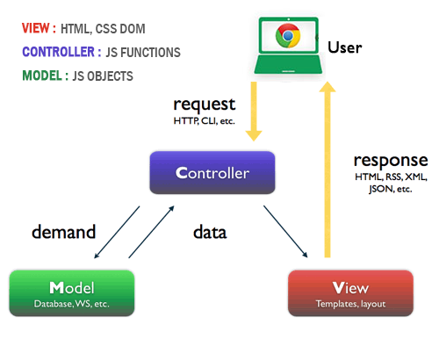
Web Developement
Unit 02: Client-Side Technologies: Java-Script and DOM
AngularJS MVC Architecture:
-MVC stands for Model View Controller.
-It is a software design pattern for developing web applications. It is very popular because it isolates the application logic from the user interface layer and supports separation of concerns.

Slide 55
Web Developement
Unit 02: Client-Side Technologies: Java-Script and DOM
S - Single
P - Page
A – Application
-Web applications have evolved from static website application to dynamic and now it’s changed to single page application.
MVC-Model View controller :
-Model view controller is the key concept of mobile or desktop application, and controller is core and the dictator for the MVC concept.
Model:
– Model is the combination of business logic and maintaining data.
View:
- View is the interface for the application, complete interface depended on views. View are dynamic it keeps change based on the user needs, views always communicates with the model to fetch the Data via controller.
Controller:
– controller is key that coordinate or control (interact) between model and views.
MVC is design pattern to create light weighted application which interact user-friendly.

Slide 56
Web Developement
Unit 02: Client-Side Technologies: Java-Script and DOM
MVC Advantages:
MVC have clear roles
Good view and readability and professional view
MVC pattern is very easy and flexible to maintain
Easy to test and for debugging
Application speed(loads smoothly and fast), saves the band width

Slide 57
Web Developement
Unit 02: Client-Side Technologies: Java-Script and DOM
-

